Slide 1
Build UWP Apps with the Microsoft Graph
Integrate the Microsoft Graph .NET SDK into an app

Slide 2

Building Microsoft Graph applications
Microsoft Graph .NET SDK
GraphServiceClient
Making Requests

Slide 3
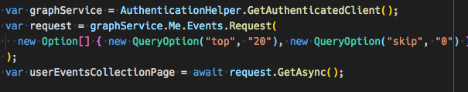
Microsoft Graph .NET SDK
Microsoft Graph REST API always available to all application types
Microsoft Graph .NET SDK abstracts the specifics of calling the REST API
https://www.nuget.org/packages/Microsoft.Graph
Handles updating HTTP request headers and other details required by the REST API
Provides a fluent API for creating Microsoft Graph requests
Notes:
Developers can leverage the Microsoft Graph REST API in any type of application
Microsoft also provides a native .NET SDK for the Microsoft Graph
Abstracts the details of working with a REST API
SDK provides a fluent API for creating requests

Slide 4
Integrating Microsoft Graph for UWP apps

Slide 5
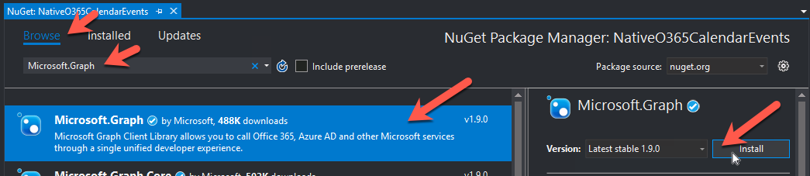
Add Microsoft Graph’s UWP SDK to the App
Microsoft Graph provides a .NET implementation of the SDK
Similar to the MSAL SDK, use NuGet to add the Microsoft Graph .NET SDK to the project
See SDK documentation for additional steps depending on the size of your project
Notes:
Just like the Azure AD MSAL .NET SDK…
The Microsoft Graph team provides a .NET SDK for .NET applications, including UWP
Add this to your project using NuGet

Slide 6
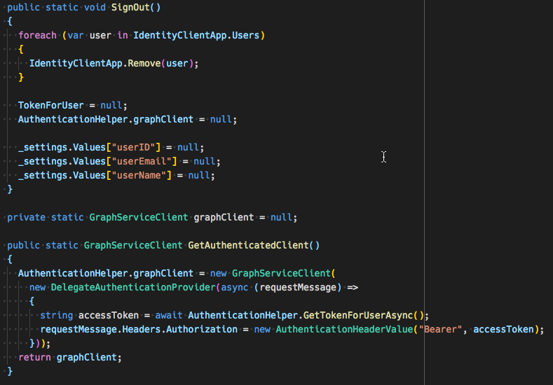
Use the Microsoft Graph .NET SDK
Notes:
Calling the Microsoft Graph with the GraphServiceClient object is very straightforward.
Use the fluent API to build a request

Slide 7
Demo

Slide 8
Thank you.

